Slide 1


Slide 2
CSCI 366 - Systems Programming
Final Review
Instructor: Carson Gross
carson.gross@montana.edu

Slide 3
Course Goals
“Introduce students to fundamental concepts in computer systems, including software environments and development tools, computer architecture and organization, concurrency, information management, network communications, and operating systems based on cloud computing.”

Slide 4
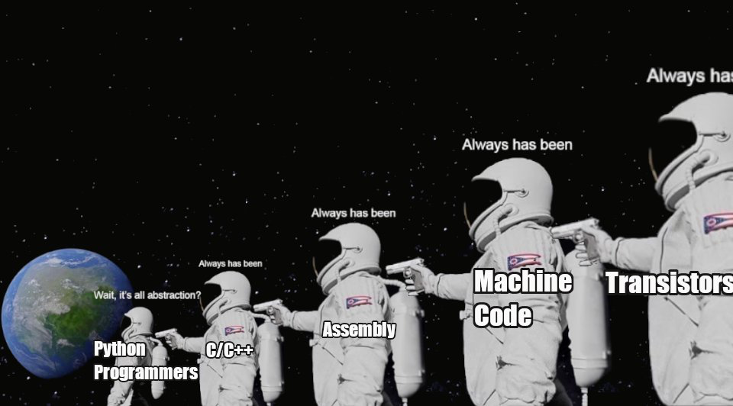
Course Goals

Slide 5
Review
Today we will go over the most important concepts that I want you to take away from the class
Please give me feedback on how to improve this class for next semester!
Improvement already planned:
Re-introduce networking assignment
Flesh out compiler section of LMSM project

Slide 6
Review
Logical operators and what's special about NAND in particular*
How to implement NAND in silicon
How an adder can be built using logical gates
Integer & floating point representation * (floating point only)
The layout & function of the Scott CPU *
The Scott CPU memory implementation *
LMC Assembly *
The Function Call Abstraction
Compilation
Bit Masking *
Networking *
Each component of the basic cloud architecture diagram *

Slide 7
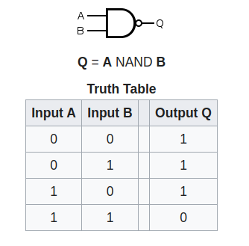
NAND Gate
NAND Gates are “special”
NAND gates are functionally complete
All other logical gates can be constructed with them
Notes:
Can be found online… but I can’t link to it

Slide 8
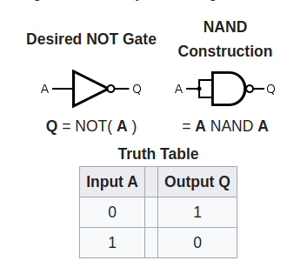
NOT Gate
To create a NOT, simply put both inputs into a NAND
Notes:
Can be found online… but I can’t link to it

Slide 9
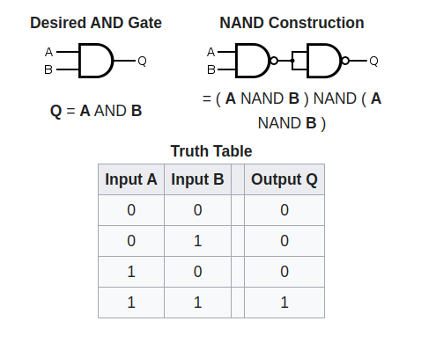
AND Gate
AND gate construction
Easy: NOT (A NAND B)
Notes:
Can be found online… but I can’t link to it

Slide 10
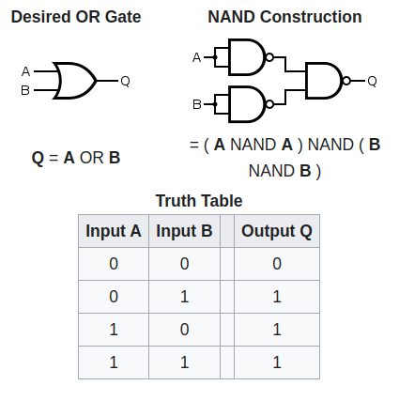
OR Gate
A little more complicated
(NOT A) NAND (NOT B)
Notes:
Can be found online… but I can’t link to it

Slide 11
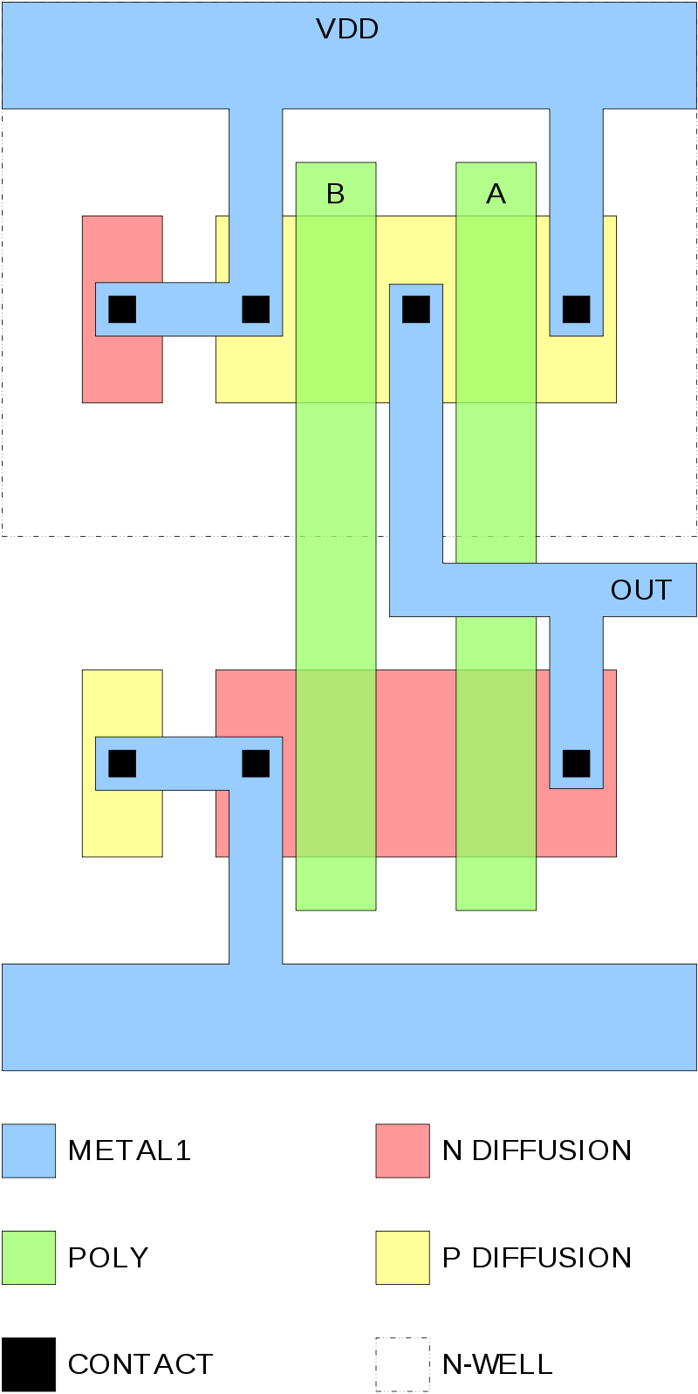
A Basic Nand Gate
At right is the basic CMOS circuit to implement an NAND gate
If both inputs A and B are high, OUT is low
Otherwise, OUT is high
All additional logical circuits can be built on top of this
Notes:
Can be found online… but I can’t link to it

Slide 12
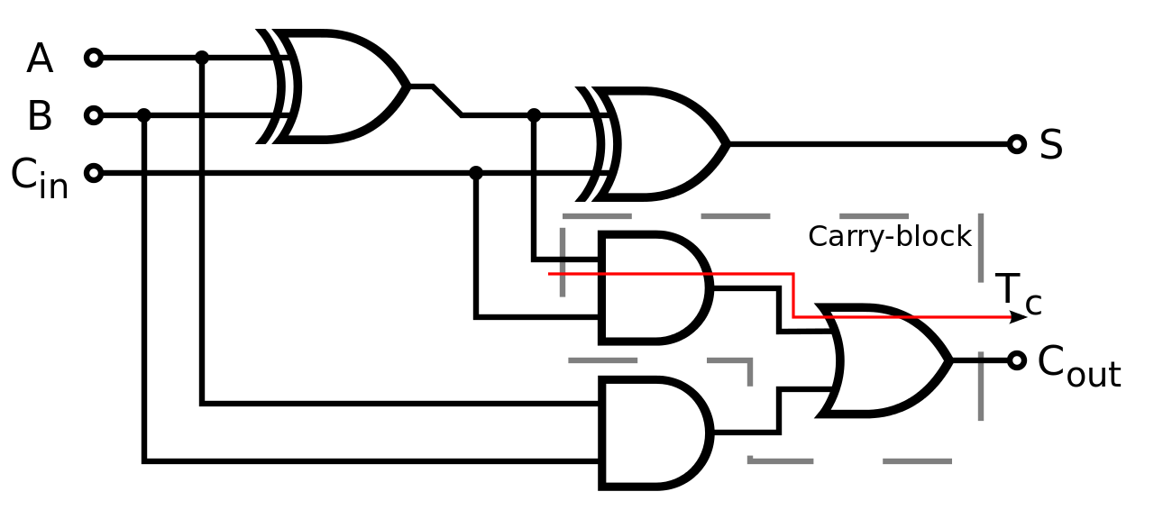
Adder Circuitry
At right is a full adder
Called a full adder because it includes a carry in and carry out bit
Built out of NANDs, ORs and ANDs
These latter two can be built out of more NANDs
Notes:
Can be found online… but I can’t link to it

Slide 13
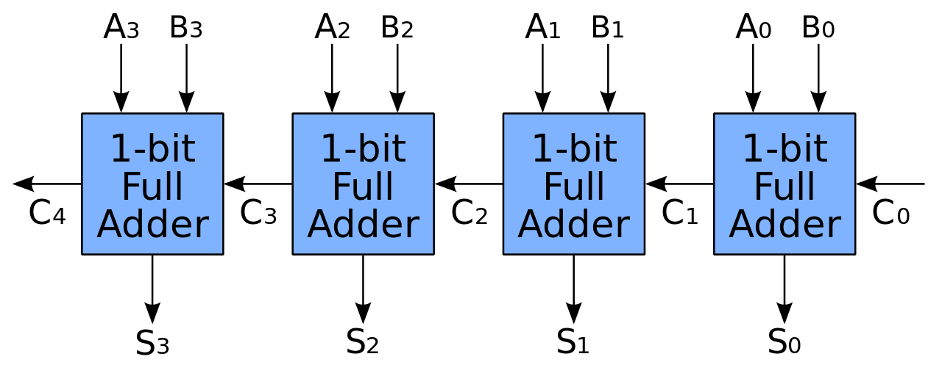
Adder Circuitry
In order to add multiple bits together, we can simply chain these adders together
This is known as a “ripple carry” adder
Real world adders are more sophisticated than this
Notes:
Can be found online… but I can’t link to it

Slide 14
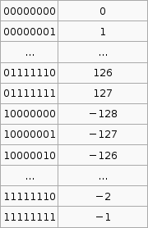
Two’s Compliment
In order to efficiently represent positive and negative integers, almost all computers use two’s complement encoding
This makes the normal adder circuitry work for both signed and unsigned integers
Notes:
Can be found online… but I can’t link to it

Slide 15
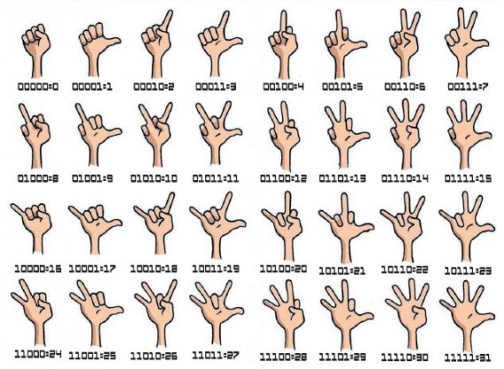
Binary Finger Counting
Remember you can count to 31 on one hand!
Notes:
Can be found online… but I can’t link to it

Slide 16
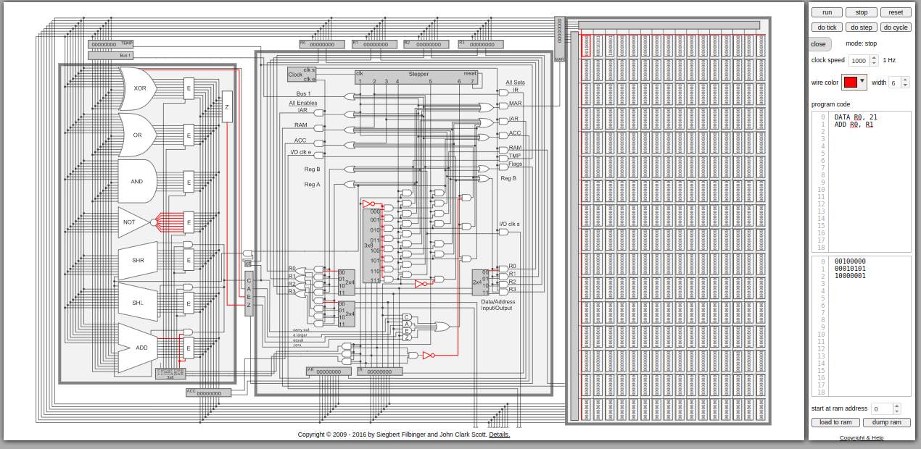
The Scott CPU
Please review the Scott CPU
In particular, please review the use of each register:
The Instruction Register
The Instruction Address Register
The Accumulator
The Temp register
The general purpose registers R0 through R1
The Memory Access Register
Notes:
Can be found online… but I can’t link to it

Slide 17
The Scott CPU
Each register performs a specific task
e.g the Instruction Address Register holds the address of the next instruction to execute
Notes:
Can be found online… but I can’t link to it

Slide 18
The Scott CPU
The Scott CPU Cycle consists of six steps:
1 - load the IAR to the MAR + bump IAR by 1 in the Accumulator
2 - load the memory location into the IR
3 - move the accumulator into the IAR (advancing it by 1)
Notes:
Can be found online… but I can’t link to it

Slide 19
The Scott CPU
The next three steps depend on the particular instruction
An add instruction:
Moves a value from a general purpose register into the TEMP register
Puts another general purpose register onto the bus + enables the adder and sets the result into the accumulator
Moves the accumulator back to a general purpose register
Notes:
Can be found online… but I can’t link to it

Slide 20
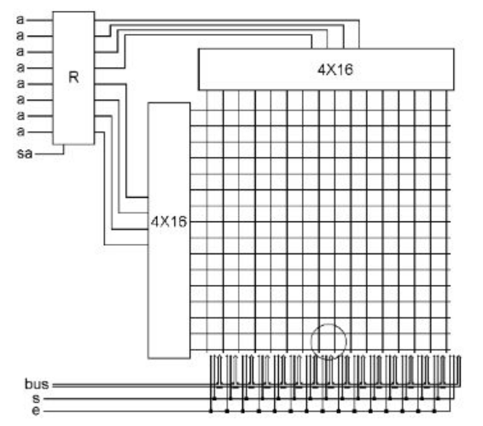
Memory
The Scott CPU memory subsystem makes uses of two decoders
A decoder takes n bits and enables 1 of n^2 wires
Here we see two 4x16 decoders, wired into the MARs top 4 and bottom 4 bits
Notes:
Can be found online… but I can’t link to it

Slide 21
Memory
Given an address in MAR, exactly one top wire and one bottom wire will be activated
Where those two wires meet is an 8 bit memory slot
This is the selected memory slot for either a read or a write
Notes:
Can be found online… but I can’t link to it

Slide 22
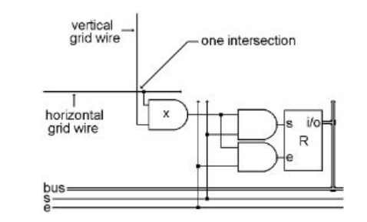
Memory
At the intersection of the wires is an AND gate
If both the vertical AND the horizontal wire are enabled, then this memory location is selected
If, additionally the set wire is enabled, the memory location is written to from the bus
If, alternatively, the enable wire is on, the memory location is put on the bus
Notes:
Can be found online… but I can’t link to it

Slide 23
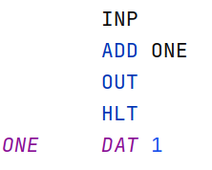
Little Man Computer
Assembly is the lowest level of programming language above machine code
Please review the basics of Little Man Computer assembly:
How INP, OUT, and ADD work
How branching works
Notes:
Can be found online… but I can’t link to it

Slide 24
Little Man Computer
In LMC there is a 1 to 1 relationship between assembly and machine code
Not so in MIPS or LMSM assembly
Why?
Notes:
Can be found online… but I can’t link to it

Slide 25
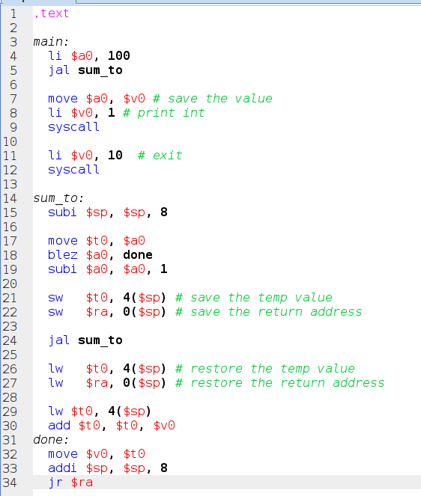
Functions
Function calls are a (perhaps the) fundamental concept to understand how high level computer languages work at the hardware level
Remember the JAL instruction:
Jumps to another area of code
Saves the next address in the return address register
Notes:
Can be found online… but I can’t link to it

Slide 26
Functions
Also important is the notion of a stack
Local function variables are stored on the stack so that things like recursion can work properly
Notes:
Can be found online… but I can’t link to it

Slide 27
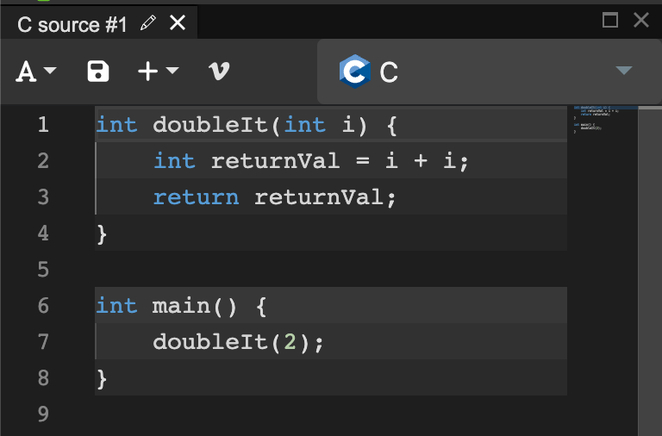
Compilers
A compiler is a piece of software that takes source and transforms it
Typically it takes high level source (like C) and transforms it into low level code (like assembly)
It takes code like we see at right
Notes:
Can be found online… but I can’t link to it

Slide 28
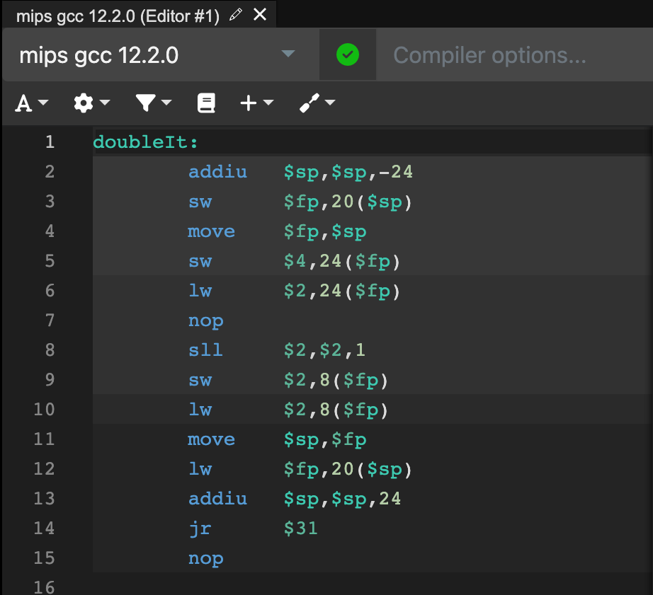
Doubling An Integer
And transforms it into assembly like this
C provides much higher level abstractions, in particular the function call, that have do be done manually in assembly
Take CSCI 468 with me to learn about compilers!
Notes:
Can be found online… but I can’t link to it

Slide 29
Bit Masking
Bit masking is a technique used sometimes in C programming
Bit masking can be used to test the value of a single bit in a larger piece of data
Useful for packing multiple booleans into a single long, for example
To get the value of a single bit, you will need to create a bit mask
A bit mask is the number 1 that has been shifted to the correct bit position

Slide 30
Bit Masking
The left bit shift operator in C is <<
This moves all the bits n slots to the left in the number
Consider binary 1010 (decimal 10) 1010 << 1 = 0100 (decimal 4) 1010 << 2 = 1000 (decimal 8) 1010 << 3 = 0000 (decimal 0)

Slide 31
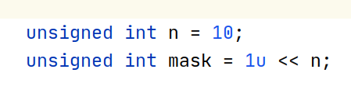
Bit Masking
Getting an bit mask for the Nth bit

Slide 32
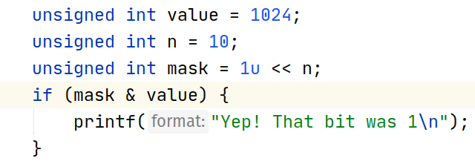
Bit Masking
Testing the Nth bit of a value

Slide 33
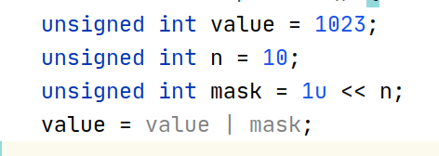
Bit Masking
Setting the Nth bit of a value

Slide 34
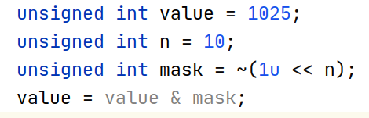
Bit Masking
Clearing the Nth bit of a value

Slide 35
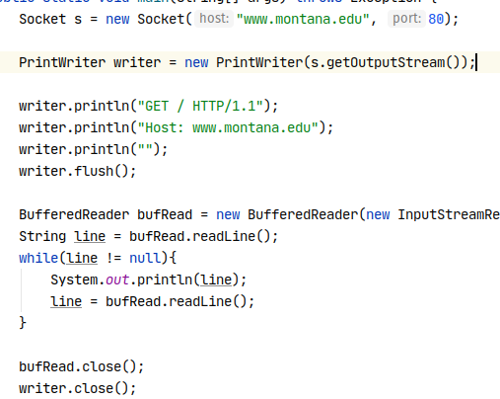
Networking
Recall that primary abstraction that programmers use when writing networking code is known as a socket
Java has a pretty nice object oriented networking library found in the java.net package
Notes:
Can be found online… but I can’t link to it

Slide 36
Networking
We discussed two different types of sockets
Please review what they are called and what each one does
Notes:
Can be found online… but I can’t link to it

Slide 37
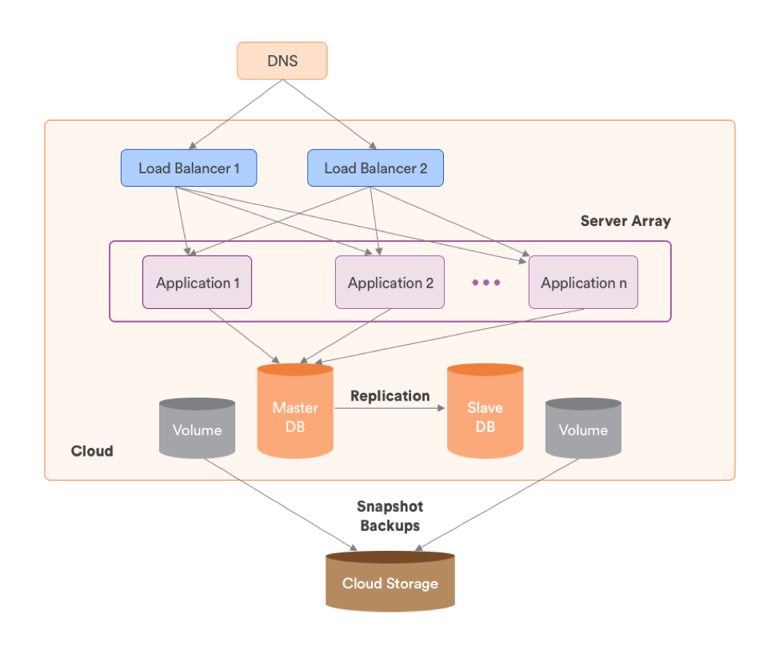
Cloud Architecture
At right is a very basic cloud architecture
DNS - Domain Name System
Load Balancers
Application Servers
Databases
Cloud Storage
Notes:
Can be found online… but I can’t link to it

Slide 38
Architecture
Which of these components must stay up?
Which of them are able to reboot without serious consequences?
Why?
Notes:
Can be found online… but I can’t link to it

Slide 39
Architecture
Which of these components must stay up?
Which of them are able to reboot without serious consequences?
Why?
Notes:
Can be found online… but I can’t link to it

Slide 40

Redis
Redis is a NoSQL data store
Remote Dictionary Service
Core concept is that of key-value pairs
Not unlike a giant hash table
Recall that redis gives us shared data structures over the network
Notes:
Can be found online… but I can’t link to it

Slide 41
Redis
In what situations would Redis be useful?
In what situations would Redis not be useful?
Notes:
Can be found online… but I can’t link to it

Slide 42

Thank You
I hope you’ve enjoyed this class and feel like you have a better understanding of how computers work, from transistors up to cloud computing!

Slide 43
